Slide 1





AURA
Fashion
Investor Pitch for
AURA

Slide 2


Agenda Overview
01
Introduction
06
Mrketing & Growth Strategy
02
Problem Statement
07
Financial Projections
03
Solution: AURA
08
The Team
04
Market Opportunity
09
Why Invest in AURA
05
Business Model
10
Q&A and Closing Remarks

Slide 3
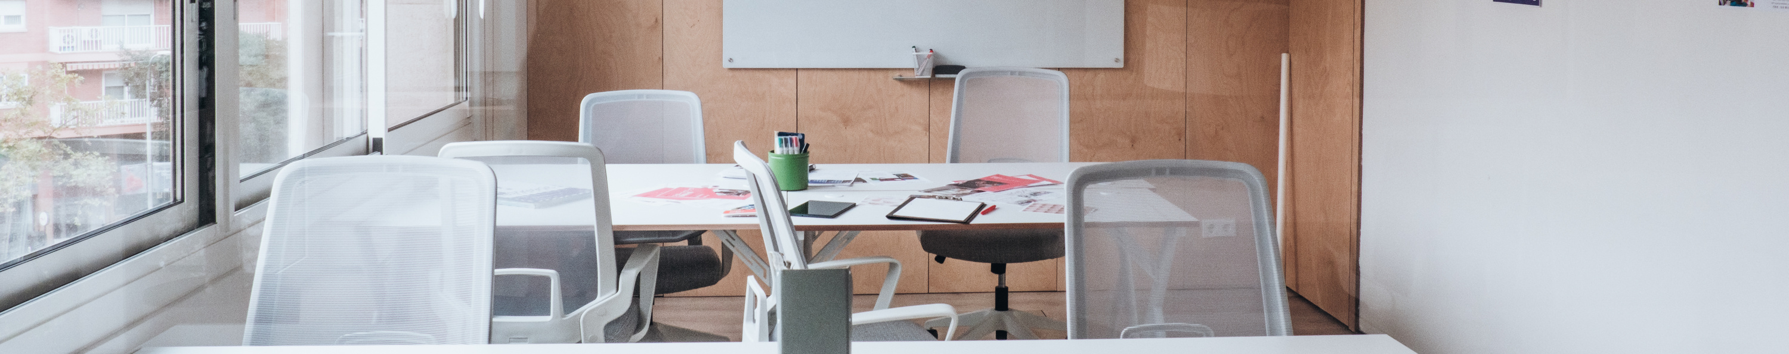
AURA
Fashion
Hello!
Welcome and thank you for taking the time to explore our innovative product – AURA. Today, we are excited to present our vision for transforming fashion with AI-powered clothing that adapts to your style and needs, all while championing sustainability.

Slide 4
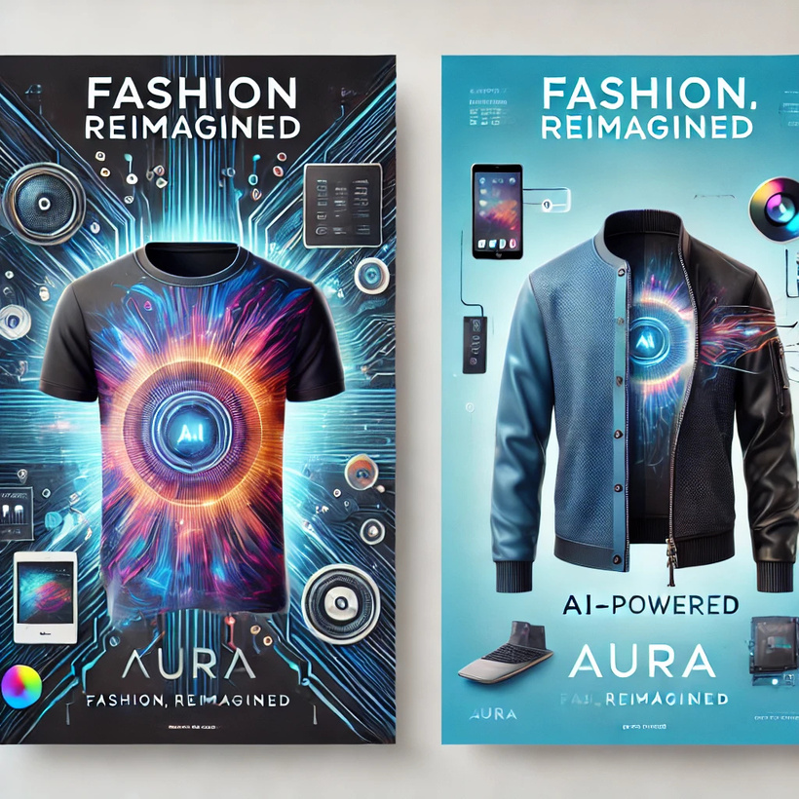
Introducing AURA
AURA is a groundbreaking innovation in fashion – a versatile, AI-powered clothing line designed to adapt to your style and enhance your wardrobe’s functionality. Combining cutting-edge technology, sustainability, and elegance, AURA is the ultimate solution for modern, conscious living.
Dynamic Design: Change colors and patterns effortlessly through a companion app, offering endless customization.
Eco-Friendly Innovation: Reduce wardrobe waste with a single garment that fits multiple occasions and styles.
Premium Quality: Engineered for comfort and durability, blending advanced fabrics with sleek aesthetics.
AURA seamlessly integrates fashion and technology, offering a revolutionary approach to self-expression, sustainability, and convenience.

Slide 5


Our Mission: Redefine Fashion, Empower Sustainability
At AURA, our mission is simple: Transform the way people interact with clothing while championing sustainability and self-expression. We believe that fashion should not only reflect individuality but also adapt to your lifestyle, offering versatility without compromise.
By integrating AI-driven customization, eco-conscious innovation, and premium design, we aim to revolutionize wardrobes and reduce fashion waste.
Our goal is to offer not just clothing but a dynamic style experience that empowers individuals to express themselves confidently while making a positive impact on the planet.

Slide 6




Problem Statement
We’re exploring the intersection of fashion, technology, and sustainability to address evolving consumer demands. Our goal is to understand market trends, overcome barriers to adoption, and position AURA as the ultimate solution for versatile, eco-conscious, and tech-enabled fashion.
Wardrobe Overload
Managing multiple outfits for various occasions leads to clutter, excessive spending, and wardrobe waste.
Lack of Versatility
Traditional clothing lacks the ability to adapt to changing styles and occasions, limiting personal expression and utility.
Style Stagnation
Outfits quickly become outdated, leaving individuals with limited ways to refresh their wardrobe without buying more.

Slide 7
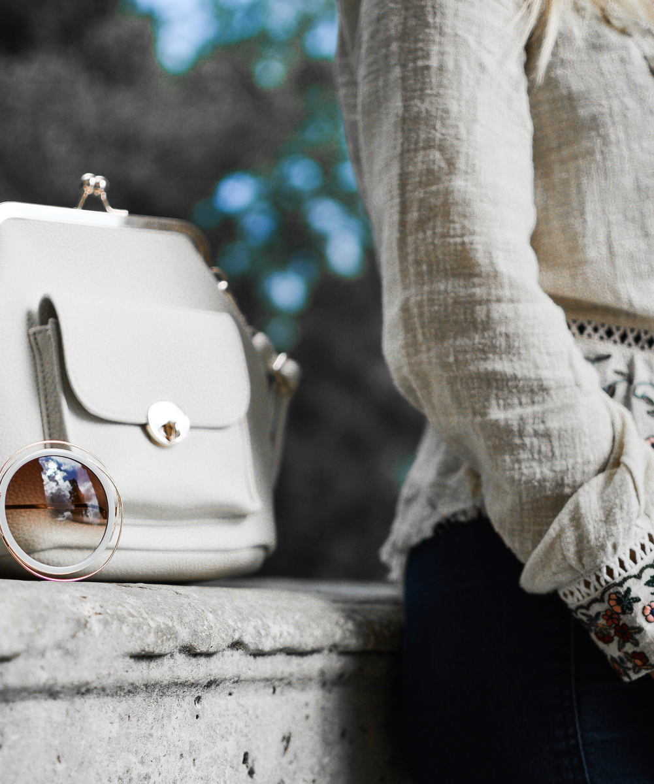

The Growing Demand for Sustainable and Adaptable Fashion
Current scenario:
As lifestyles become more dynamic, consumers are seeking versatile clothing that aligns with their evolving needs and values.
The increasing awareness of environmental impact and the demand for personalized, tech-integrated fashion have created a unique opportunity for sustainable innovation in the apparel industry.

Slide 8


The Solution: AURA
Dynamic Design
Say goodbye to wardrobe monotony! AURA allows you to change colors and patterns effortlessly through a user-friendly app, giving you infinite style possibilities.
Sustainable Innovation
Reduce wardrobe waste with eco-friendly fabrics and a single outfit that adapts to multiple occasions, aligning with your values and the planet’s needs.
Personalized Style
AURA empowers you to express yourself with real-time customization, ensuring your clothing fits your mood, event, or lifestyle seamlessly.
Premium Quality and Comfort
Crafted with advanced fabrics and cutting-edge technology, AURA offers durability, comfort, and elegance in every outfit.
Future-Ready Fashion
A tech-integrated wardrobe that addresses the growing demand for adaptable, sustainable, and versatile clothing in today’s dynamic world.
Say goodbye to the limitations of traditional fashion! AURA is not just clothing—it’s a game-changing innovation that combines AI-driven customization, sustainable design, and premium quality to transform your wardrobe into a versatile and eco-conscious style solution.

Slide 9


Market Opportunity
Market Size:
Apparel Market: Valued at approximately $1.79 trillion in 2024, with a projected annual growth rate of 2.81% between 2024 and 2028.
Wearable Technology Market: Valued at $61.30 billion in 2022, expected to grow at a CAGR of 14.6% from 2023 to 2030.
Growth fueled by:
Increasing demand for versatile, personalized fashion solutions.
Growing awareness and preference for sustainable, eco-conscious products.
Rising interest in tech-enabled clothing for enhanced functionality and convenience.

Slide 10

Business Model
Revenue Streams:
Direct-to-Consumer Sales:
Selling AURA garments directly to customers through our official website and popular e-commerce platforms.
Retail Partnerships:
Partnering with fashion retailers and boutique stores to expand accessibility and brand presence.
Subscription Services:
Offering a subscription-based model for exclusive access to new patterns, designs, and app features, keeping customers engaged and wardrobes fresh.
Licensing Technology:
Monetizing our proprietary AI customization and fabric technology by licensing it to other brands in the fashion and wearable tech industries.

Slide 11

Marketing Campaign for AURA

Slide 12

Branding and Positioning: Versatility Meets Sustainability
USP (Unique Selling Proposition):
AURA fuses cutting-edge AI technology with sustainable, premium fashion, providing limitless style options in a single garment.
Target Audience:
Eco-Conscious Consumers: Individuals seeking sustainable and environmentally friendly fashion choices.
Style Enthusiasts: Fashion-forward individuals who value personalization and versatility in their wardrobe.
Tech-Savvy Millennials and Gen Z: Early adopters of wearable technology and app-integrated solutions.

Slide 13

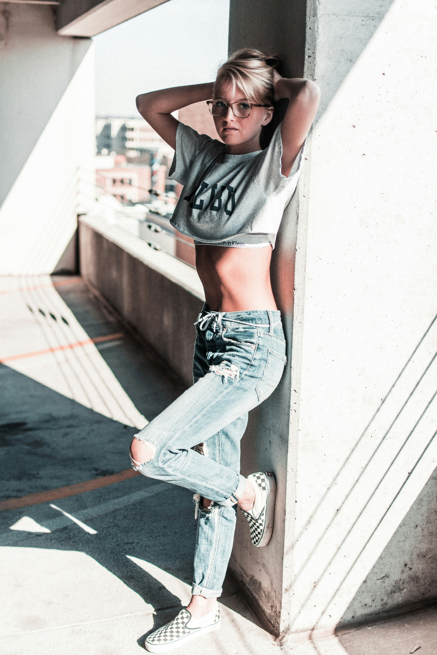
Social Media
We use social media to connect with our community and share our mission of sustainable, tech-driven fashion. Our platforms provide a space to showcase new designs, feature customer stories, and offer style inspiration. Through engaging content, we invite followers to explore the limitless possibilities of customizable clothing. We’re committed to building an online presence that promotes creativity, inclusivity, and sustainability. Join us as we redefine the future of fashion with every post. Follow for updates, promotions, and behind-the-scenes content.
342K
200K
22K
Follower
Likes
Share

Slide 14

Ad Campaigns
YouTube Ads:
Captivating stories showcasing AURA’s ability to transform a single outfit into endless styles, emphasizing sustainability and innovation.
Instagram Reels:
Eye-catching reels demonstrating AURA’s dynamic design features, such as real-time pattern changes, with a focus on style and versatility.
Google Ads:
Targeting searches like “sustainable fashion,” “customizable clothing,” and “AI-powered apparel” to reach eco-conscious and tech-savvy consumers.

Slide 15


Expansion Plans
Product Line Diversification | Geographical Growth | Retail Presence | Collaborations
Introduce new clothing categories like outerwear, accessories, and activewear with AURA’s signature customizable and sustainable technology. | Expand into international markets, starting with eco-conscious regions such as Europe, North America, and parts of Asia. | Establish partnerships with premium fashion retailers and open flagship stores in major cities to enhance brand visibility and customer experience. | Partner with designers, influencers, and sustainability advocates to co-create exclusive collections and drive brand awareness.

Slide 16
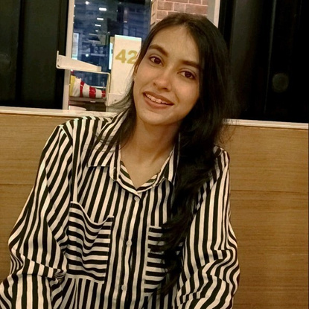
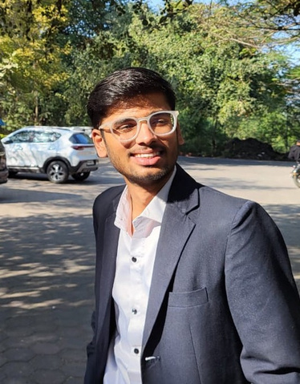
Our Team
Isha Mahajan
Founder
Our team is a diverse group of visionaries, designers, engineers, and sustainability advocates united by a passion for transforming the fashion industry. With expertise in AI technology, fashion design, and eco-friendly practices, each member plays a vital role in bringing our innovative ideas to life. We collaborate across disciplines to create clothing that’s not only stylish and functional but also forward-thinking and environmentally responsible. Together, we are shaping the future of fashion, one sustainable, customizable garment at a time.
Isha Mahajan, the visionary behind AURA, founded the brand with a mission to merge fashion, technology, and sustainability. With a passion for innovation and a deep commitment to reducing the environmental footprint of fashion, Isha has led the charge in creating versatile, eco-friendly clothing that empowers individuals to express their style while embracing a more sustainable future.
Shivam Rathod
Co-Founder
Shivam Rathod, Co-Founder of AURA, brings his expertise in AI and technology to the brand. His commitment to revolutionizing the fashion industry through intelligent design and sustainable practices has been instrumental in shaping AURA’s innovative product line. Shivam’s vision is to create a future where fashion is both personalized and eco-conscious, offering limitless possibilities for every individual.

Slide 17


Advisors and Partners
Design Advisor:
Partnered with leading textile technologists and fashion designers to ensure AURA’s garments are both aesthetically appealing and technologically advanced.
Sustainability Consultant:
Collaborating with eco-conscious organizations to optimize sustainable materials and processes, reinforcing our commitment to the environment.
Marketing Consultant:
Engaged a digital marketing agency specializing in tech-driven lifestyle brands to enhance online presence and build trust with consumers.
Tech Partners:
Collaboration with Smart Fabric Innovations Inc. for integrating dynamic, customizable fabric technology.
Support from AI Wearable Solutions for developing the intuitive app and real-time customization features.

Slide 18
Why Invest in AURA ?
Impressive Financial Projections:
Exceptional Market Opportunity
Year 1: $1.5M revenue with a 25% profit margin, driven by strong domestic market sales and online presence.
Year 2: $5M revenue fueled by international expansion into eco-conscious markets like Europe and North America.
Year 3: $10M revenue with a 40% profit margin, supported by product diversification and technology licensing.
Break-even Point: Achievable within the first 16 months of launch.
The global sustainable fashion market is projected to reach $15 billion by 2026, growing at a CAGR of 9.1%.
The wearable tech market is valued at $61 billion, with a CAGR of 14.6%, reflecting growing consumer demand for tech-integrated apparel.
Rising awareness of environmental impact and demand for personalized, versatile fashion creates a significant opportunity for AURA’s AI-powered, eco-friendly clothing line.

Slide 19
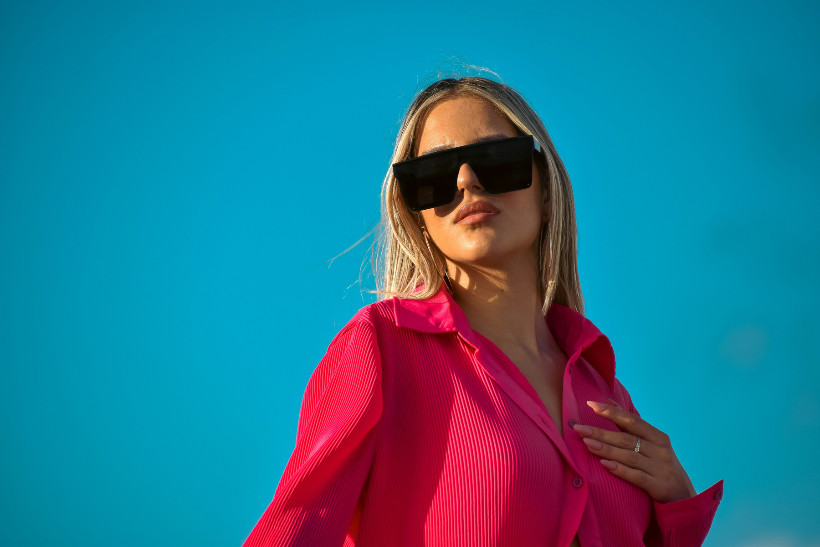




Q&A and Closing Remarks
Open Floor for Questions:
We welcome your questions and look forward to addressing any queries you may have about AURA and our vision for the future of fashion.
www.aurafashion.com
contact@aurafashion.com
+1 (800) 123-4567
Indore, Madhya Pradesh, India

Slide 20

AURA
Fashion
Thank You

